Slide 1
TIME SERIES ANALYSIS OF DAILY CRUDE OIL PRODUCTION - A DATA QUALITY ASSESSMENT Submitted by: Nidhi Mankala

Slide 2
Open source softwares used:
Python 3.9
Jupyter notebook
Microsoft SQL Server Management Studio 17
Spotfire 11.5.0
R studio

Slide 3
Dataset
The dataset contains DCP values for everyday from 1/1/2016 to 16/10/2021
It contains 4 columns
LevelType: Field or GC
LevelName: RA,SA,AD,RQ, undefined
Date
DCP Integer

Slide 4
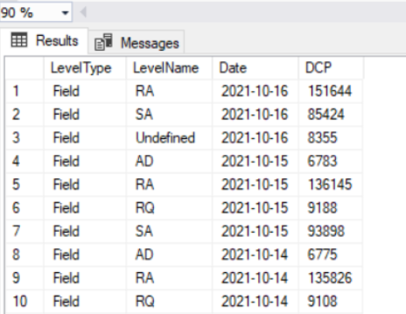
Dataset captured from Microsoft SQL Server

Slide 5
What is time series analysis
Time series data is a collection of observations obtained through repeated measurements over time. Plot the points on a graph, and one of your axes would always be time.An observed time series can be decomposed into three components: the trend (long term direction), the seasonal (systematic, calendar related movements) and the irregular (unsystematic, short term fluctuations).
A seasonal effect is a systematic and calendar related effect. Some examples include the sharp escalation in most Retail series which occurs around December in response to the Christmas period, or an increase in water consumption in summer due to warmer weather.
Time series analysis typically requires a large number of data points to ensure consistency and reliability. An extensive data set ensures you have a representative sample size and that analysis can cut through noisy data. It also ensures that any trends or patterns discovered are not outliers and can account for seasonal variance.

Slide 6
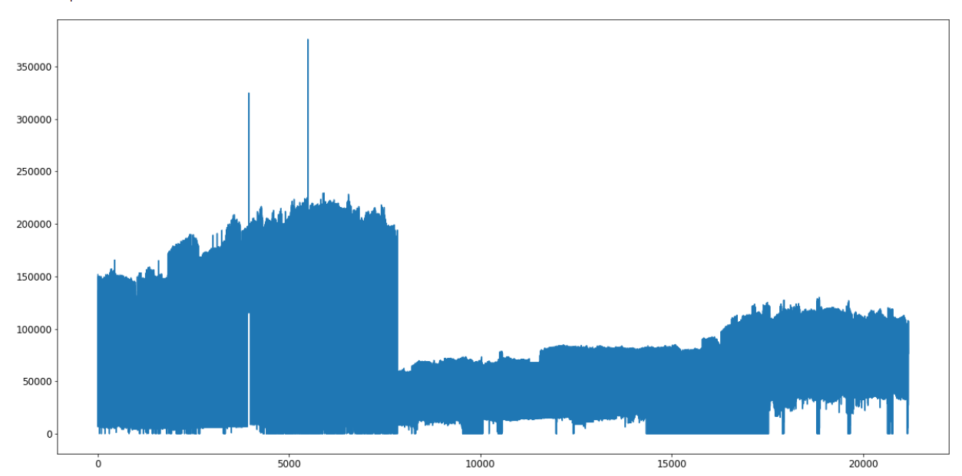
I)Data preprocessing and cleaning
Plotting the graph before processing the data

Slide 7
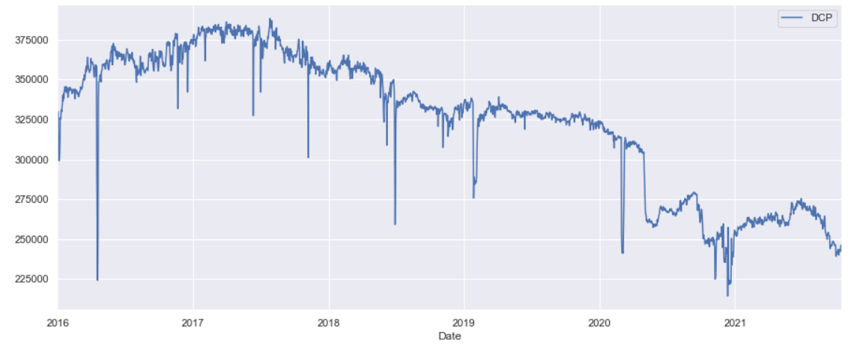
Aggregating the data according to individual GC and dropping the null values

Slide 8
II)Test of Stationarity
After preprocessing the data, we need to check the stationarity of the data. A dataset is said to be stationary if the mean, variance and autocorrelation remain constant. To check the stationarity, there are a few tests to apply.
Rolling mean/ moving average : A moving average is a technique to get an overall idea of the trends in a data set; it is a calculation to analyze data points by creating a series of averages of different subsets of the full data set.

Slide 9
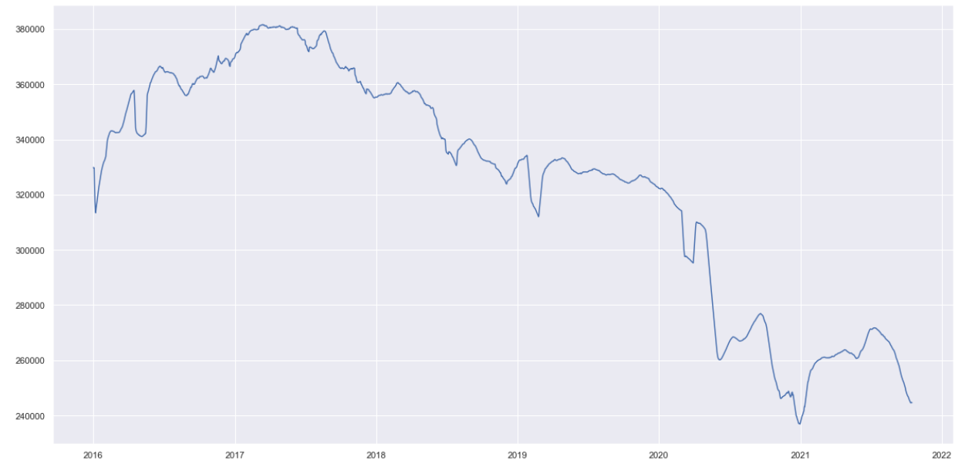
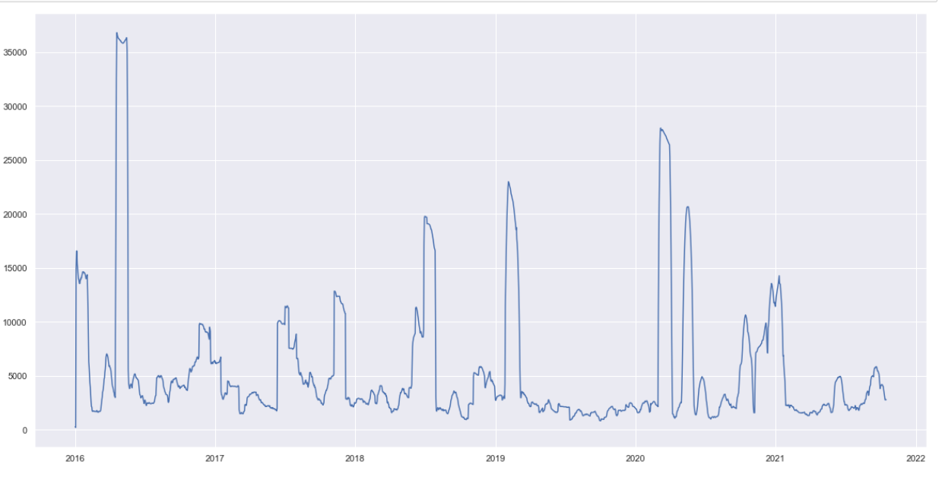
#Test1 - Rolling statistics
For this test, we plot the rolling mean and rolling variance of the data and observe whether the visualisation is constant in its mean and variance. Both variance and mean have to be constant for this test to pass.
As observed above, the rolling mean is not constant as it is following the downward trend. The rolling variance is a relatively constant plot. Therefore, the data does not pass the first stationarity test.

Slide 10
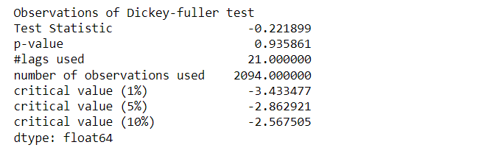
#Test2 - Augmented Dickey Fuller Test (ADF test)
If p-value is very less than the significance level of 0.05 and we can reject the null hypothesis and consider the series is stationary. But in our case the p-value is 0.935 > 0.05 and hence we cannot reject the null hypothesis and the series is not stationary

Slide 11
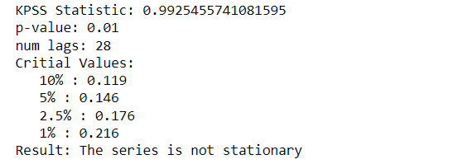
#Test3- KPSS (Kwiatkowski-Phillips-Schmidt-Shin)
In this test, if p-value is < signif level (say 0.05), then the series is non-stationary. We can observe that the p-value is 0.01 < 0.05 and therefore the data is not stationary

Slide 12
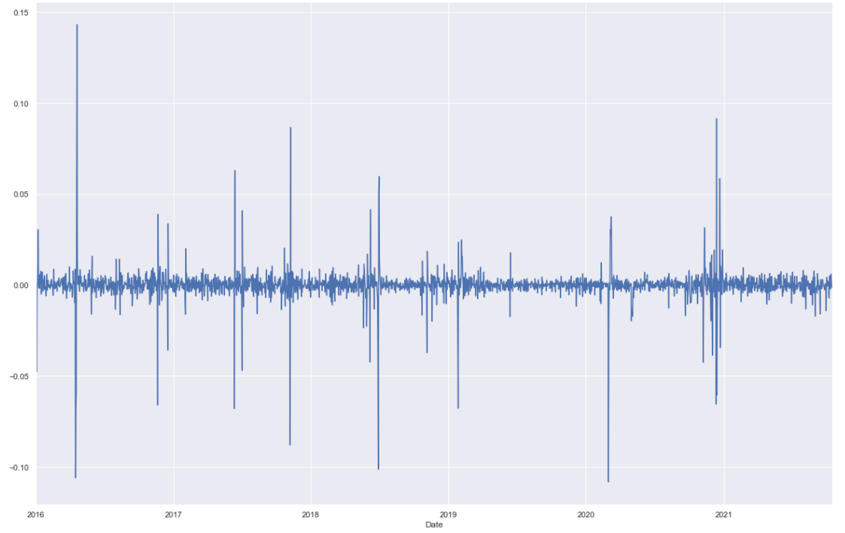
III)Converting the series into stationary series
Differencing is computing the differences between consecutive observations. This is one of the methods to convert non-stationary data into stationary.
Plotting after the differencing of the data. It can be observed that the visual representation demonstrates a stationary dataset
By applying the 3 test of stationarity on the modified dataset, it can be concluded that the series is now stationary

Slide 13
IV)Decomposition of data
A time series has 4 main components namely, seasonality, trend, cyclicity and residuals.
Trend component: The long-term pattern shown by a time series is called as trend. A trend can be positive or negative depending on whether the time series exhibits an increasing long-term pattern or a decreasing long-term pattern. In other words, we can say a time series has upward trend if it has an overall growth and for negative trend, it shows overall negative growth. If a time series does not show an increasing or decreasing pattern then the series is stationary in the mean.
Seasonal component: Seasonality occurs when the time series exhibits regular fluctuations during the same month (or months) every year, or during the same quarter every year. For instance, in case of sales data of car companies, usually the car companies give a huge discount in the month of December, so there sales increase in the month of December. This happens every year.
Cyclical component: We say the data has a cyclic component when it exhibits rises and falls that are not of fixed period. The duration of a cycle depends on the type of business or industry being analysed.
Irregular component: This component is unpredictable. Every time series has some unpredictable component that makes it a random variable.

Slide 14
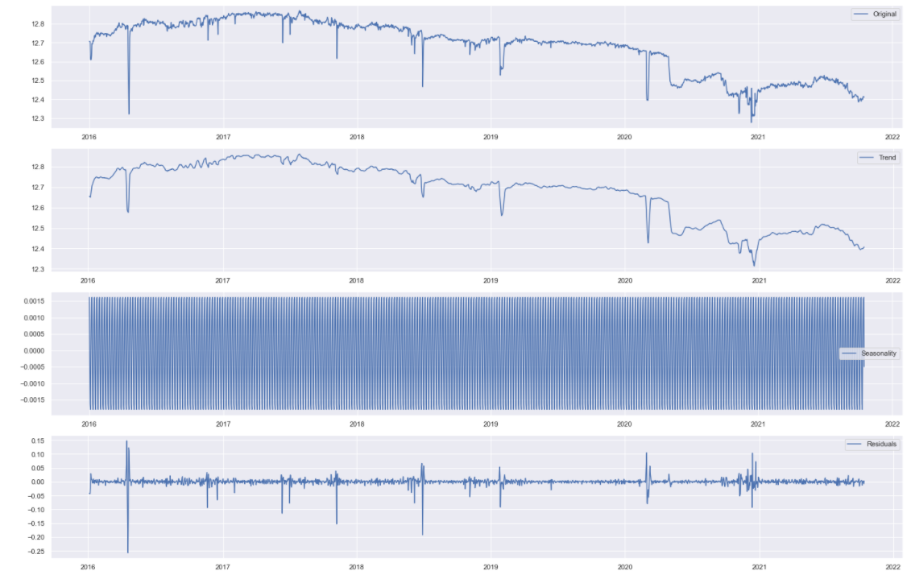

Slide 15
V) Statistical Models
1)Autoregressive Integrated Moving Average (ARIMA)
In an ARIMA model there are 3 parameters that are used to help model the major aspects of a times series: seasonality, trend, and noise. These parameters are labeled p,d,and q.
Number of AR (Auto-Regressive) terms (p): p is the parameter associated with the auto-regressive aspect of the model, which incorporates past values i.e lags of dependent variable.
Number of Differences (d): d is the parameter associated with the integrated part of the model, which effects the amount of differencing to apply to a time series.
Number of MA (Moving Average) terms (q): q is size of the moving average part window of the model i.e. lagged forecast errors in prediction equation.

Slide 16
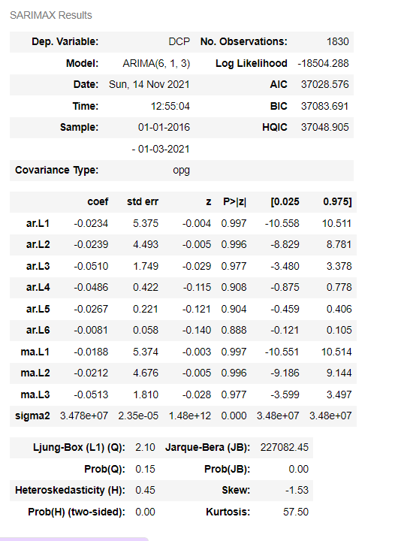
Observations from ARIMA model (6,1,3)

Slide 17
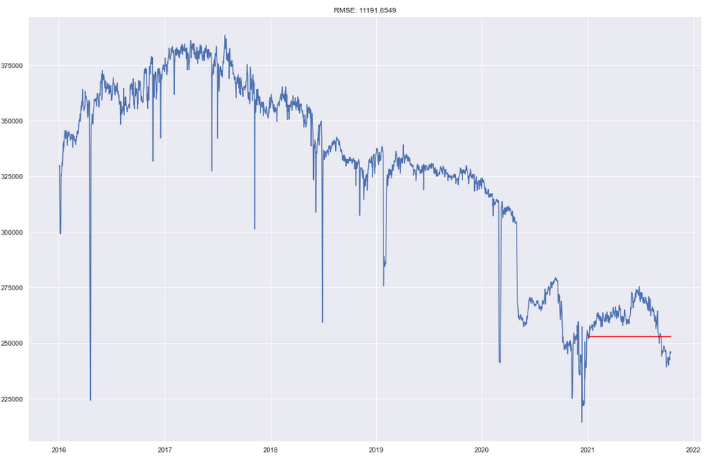
Inference: It can be observed that the predictions and the actual values are not in alignment due to the convergence of the time series to the mean. Therefore this model does not give a very accurate predictions of the DCP value

Slide 18
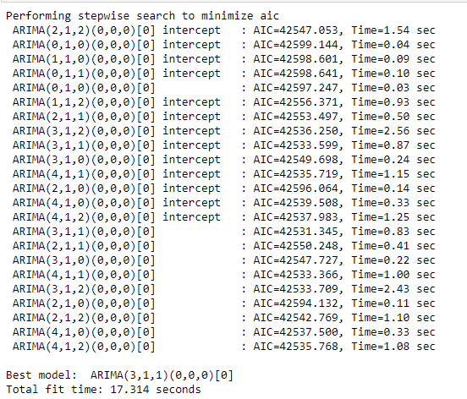
2)Seasonal Autoregressive Integrated Moving-Average (SARIMA)
It is an extension of ARIMA that explicitly supports univariate time series data with a seasonal component.This model finds the optimal value for p,q,d for all different combinations and calculates the Akaike's Information Criterion (AIC). The combination with the lowest AIC is chosen as the optimal value. In the above figure, the lowest AIC= 42531 is for the model with values (3,1,1)

Slide 19
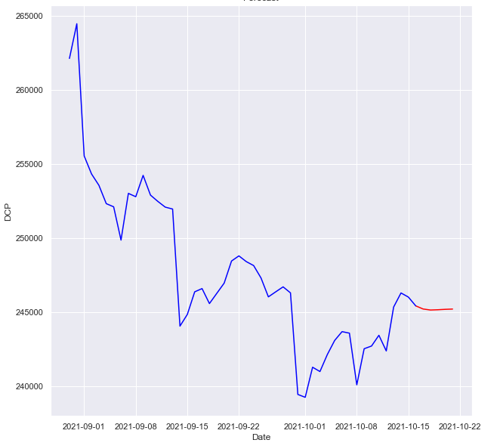
Predictions of the SARIMA model

Slide 20
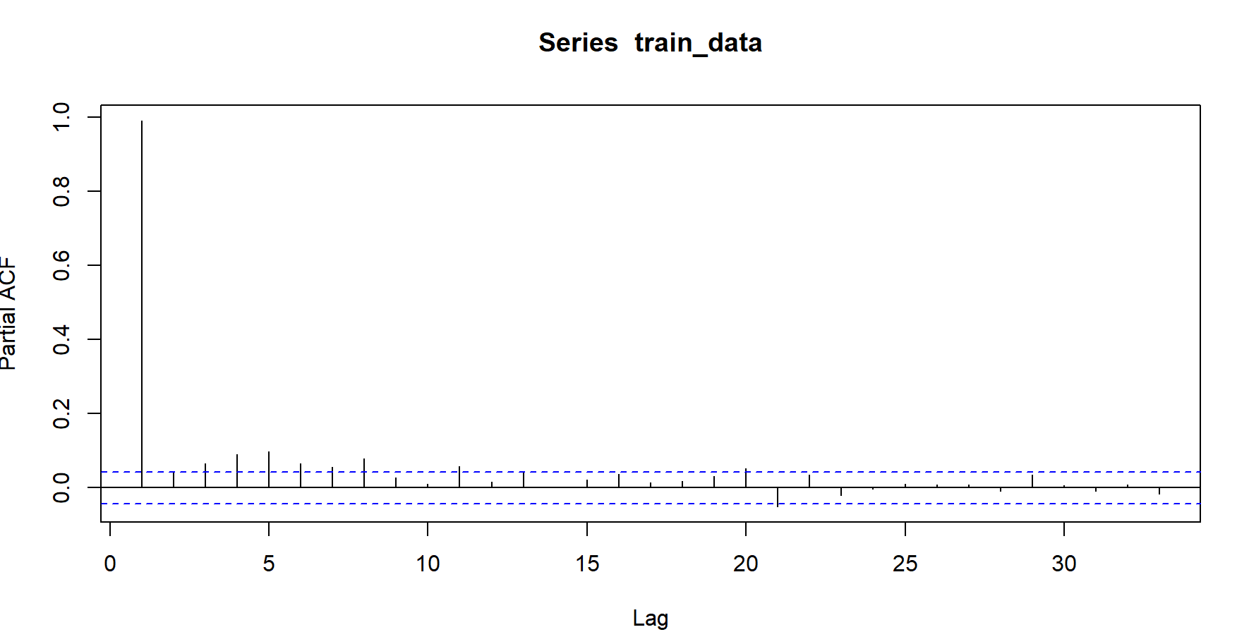
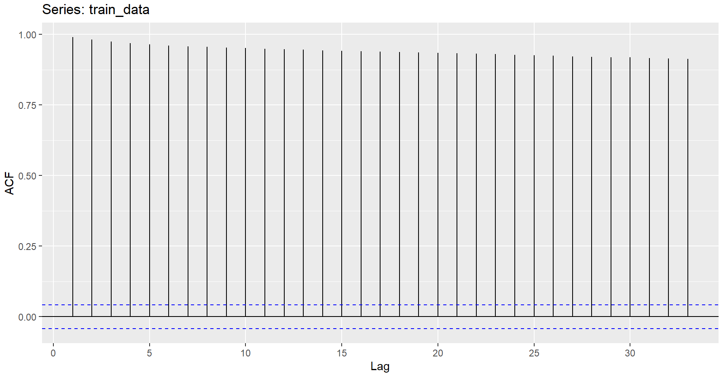
AutoCorrelation Function (ACF) Plot and partial autocorrelation function (PACF)

Slide 21
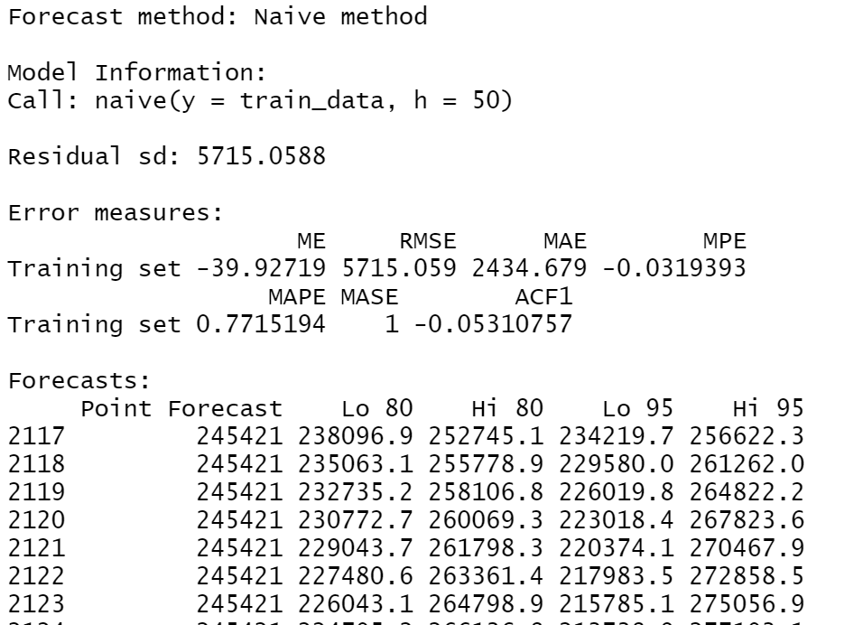
3)Naive bayes method
Naïve Bayes algorithm is a supervised learning algorithm, which is based on Bayes theorem and used for solving classification problems.It is a probabilistic classifier, which means it predicts on the basis of the probability of an object.Bayes' theorem is also known as Bayes' Rule or Bayes' law, which is used to determine the probability of a hypothesis with prior knowledge. It depends on the conditional probability.

Slide 22
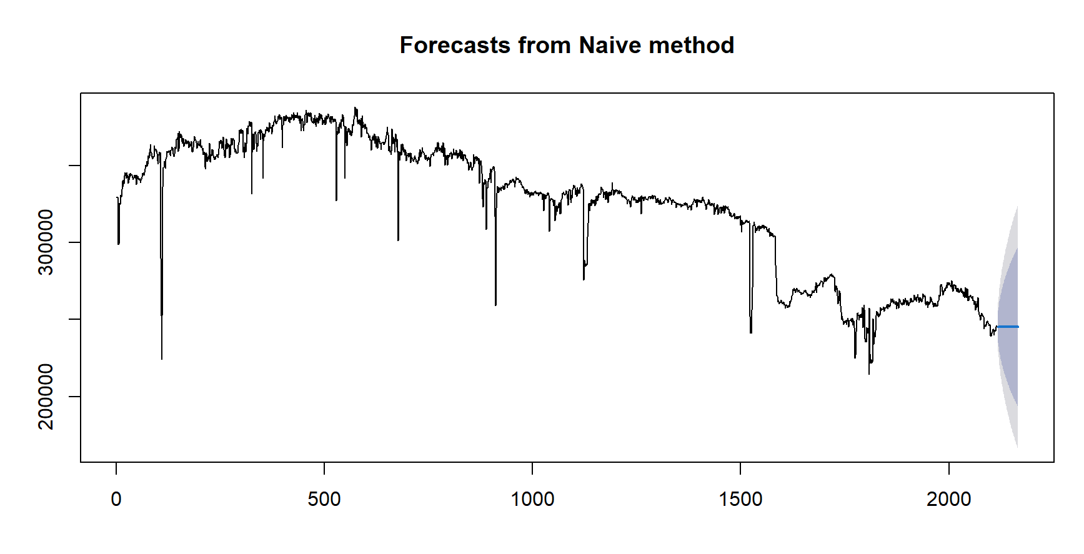

Slide 23
4)Holts- winter model
Holt-Winters is a model of time series behavior. Holt-Winters is a way to model three aspects of the time series: a typical value (average), a slope (trend) over time, and a cyclical repeating pattern (seasonality).The Holt-Winters method uses exponential smoothing to encode lots of values from the past and use them to predict “typical” values for the present and future.

Slide 24
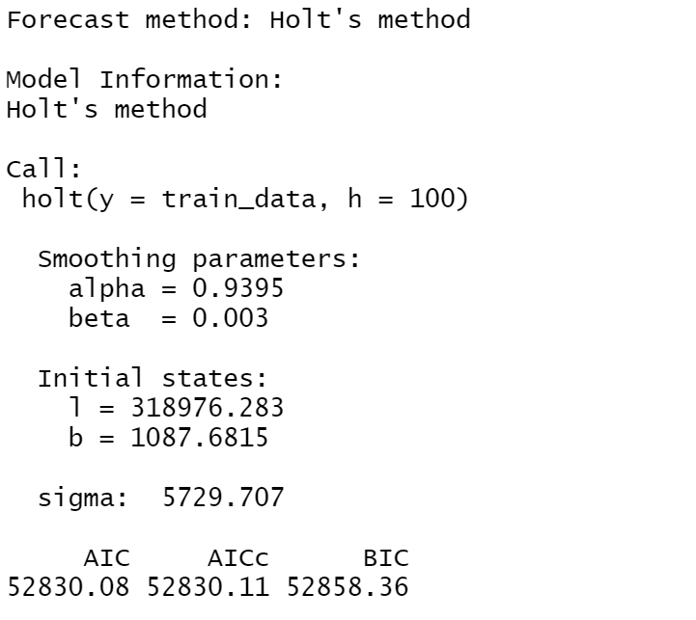
Observations from holt’s method

Slide 25
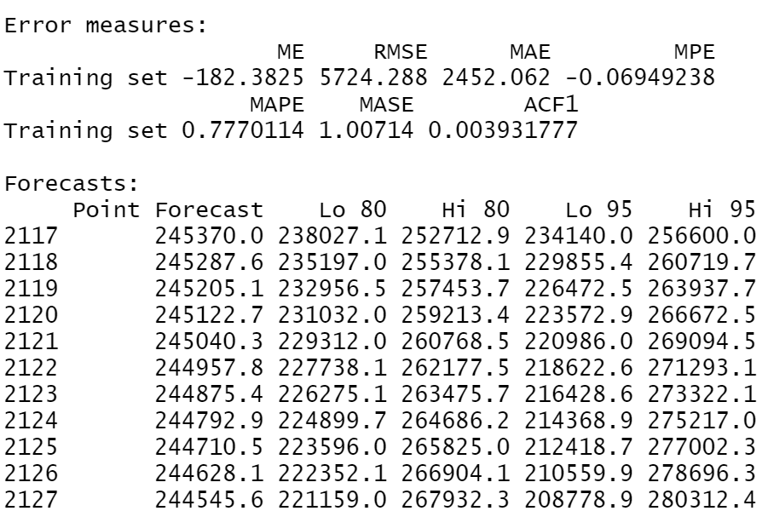
Error measures and forecast of holt’s method

Slide 26
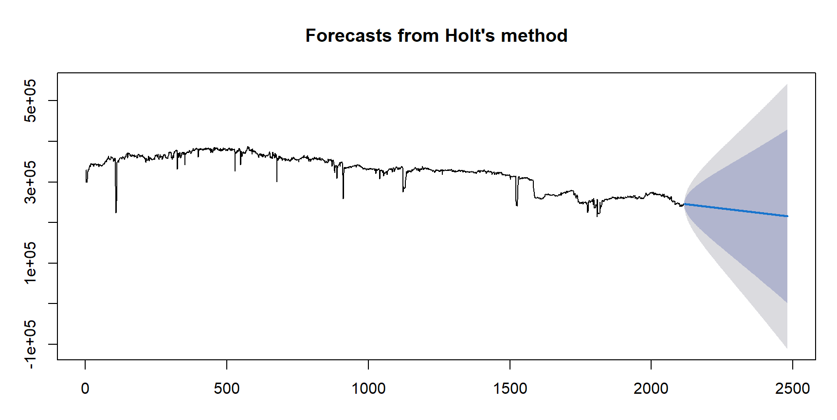

Slide 27
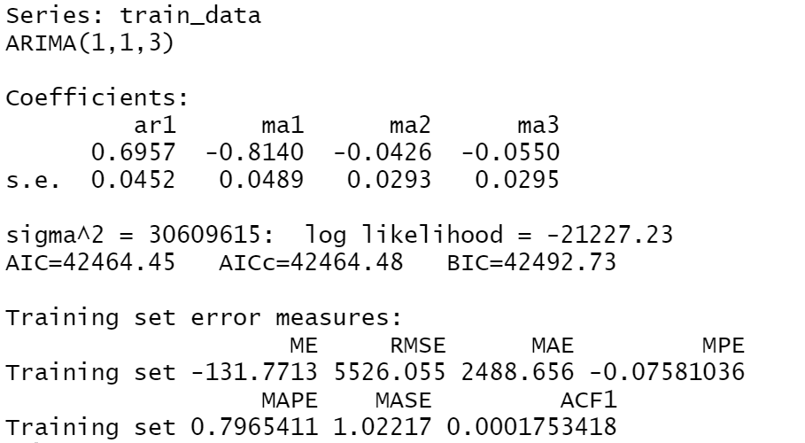
5)ARIMA (1,1,3)

Slide 28
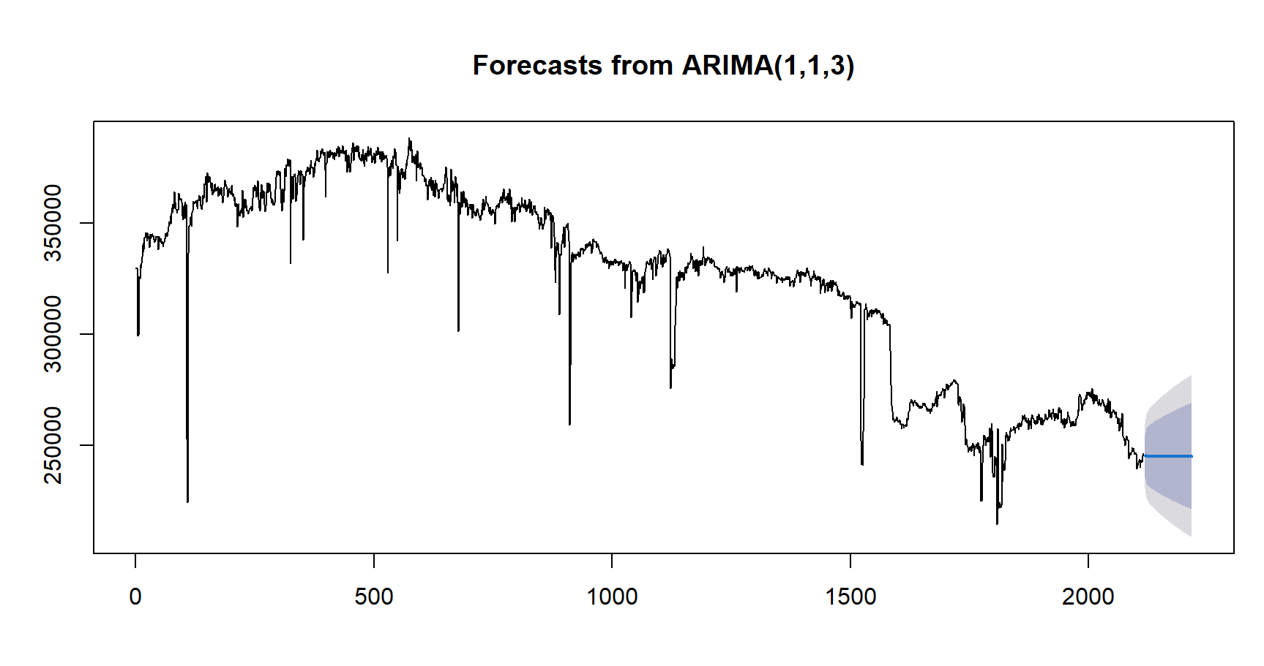

Slide 29
6) Double-Seasonal Holt-Winters Forecasting
This method uses additive trend and multiplicative seasonality, where there are two seasonal components which are multiplied together.
Seasonal component 1 - period1=12
Seasonal component 2 - period2=360
The model essentially enables it to capture two seasonal cycles of the data.a smaller one repeated often and a bigger one repeated less often. For the method to work however, the seasonalities need to be nested, meaning one must be an integer multiple of the other.

Slide 30
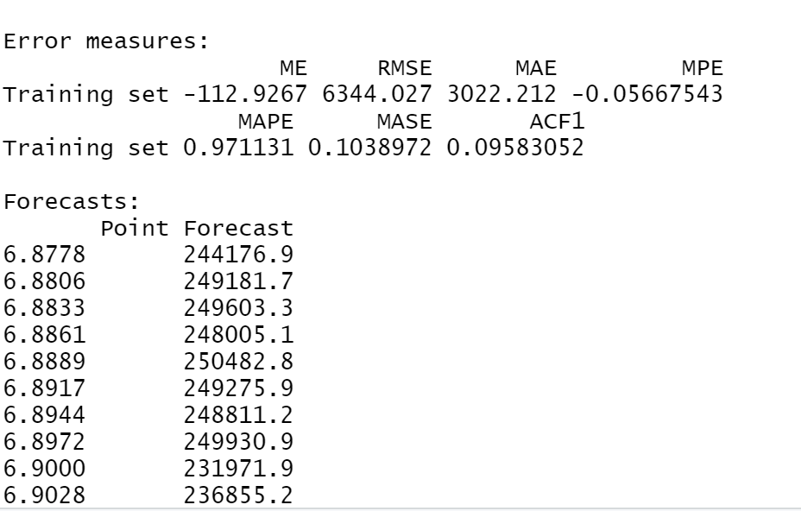

Slide 31
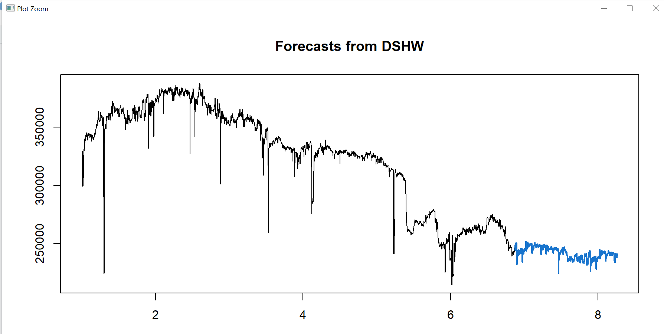

Slide 32
RESULTS
Statistical/ machine learning models used:
ARIMA (6,1,3)
SARIMA
Naive bayes
Holts-winter
ARIMA (1,1,3)
Double seasonal holts winter (DSHW)
On comparing the results of different models, it can be inferred that the double seasonal holts winter model gave the best predictions of the DCP values.

Slide 33
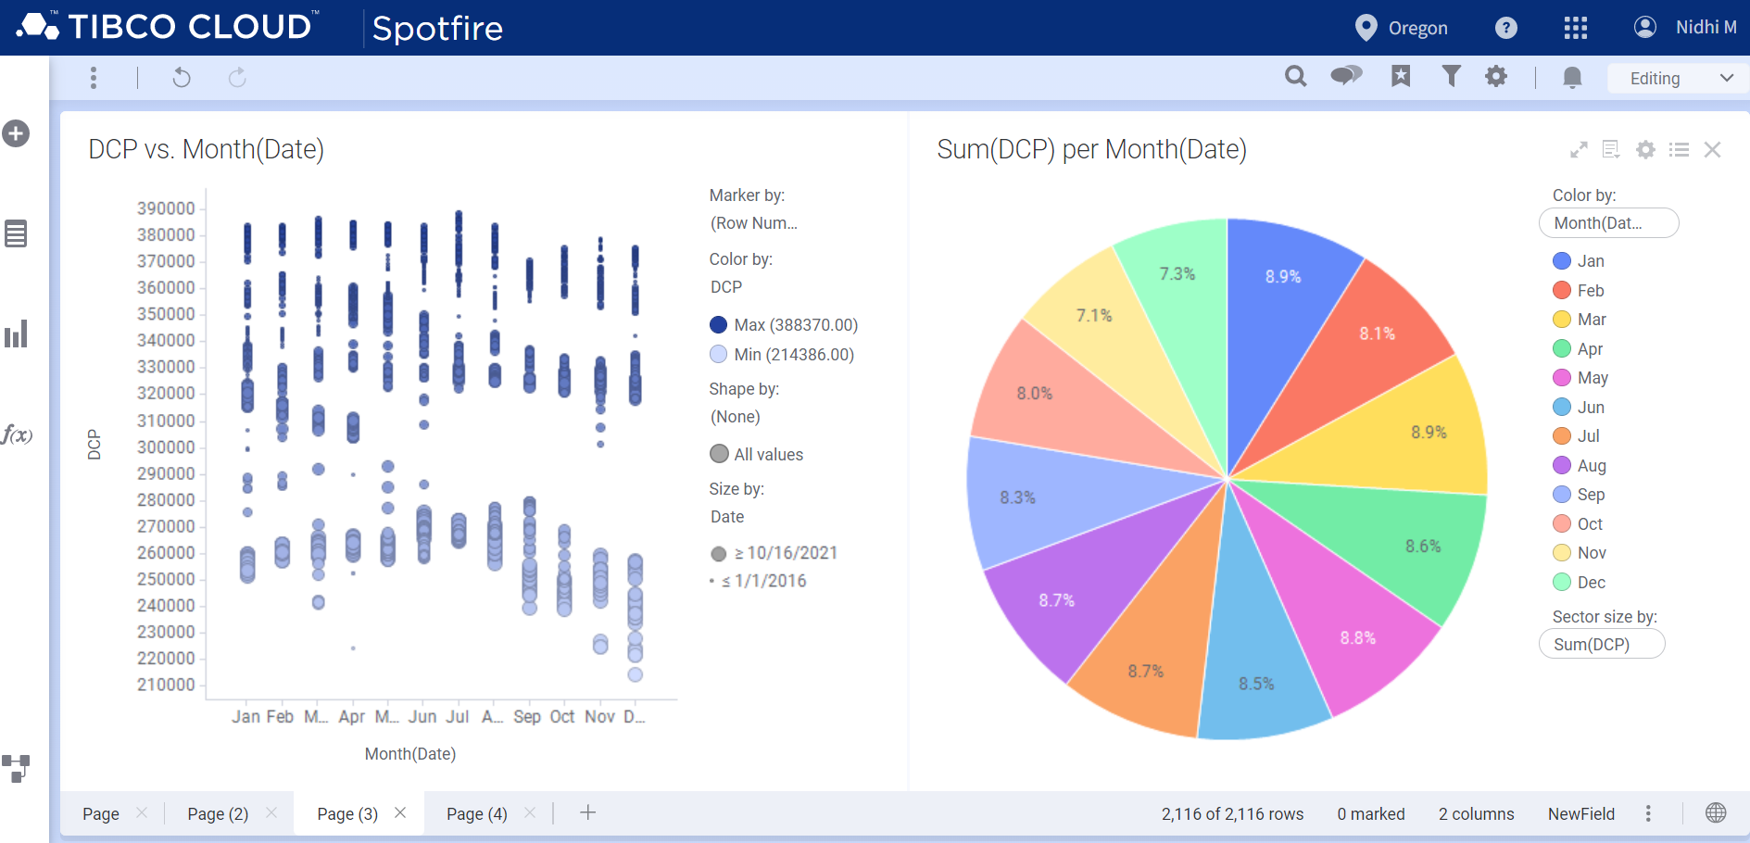
Data Visualization using spotfire

Slide 34
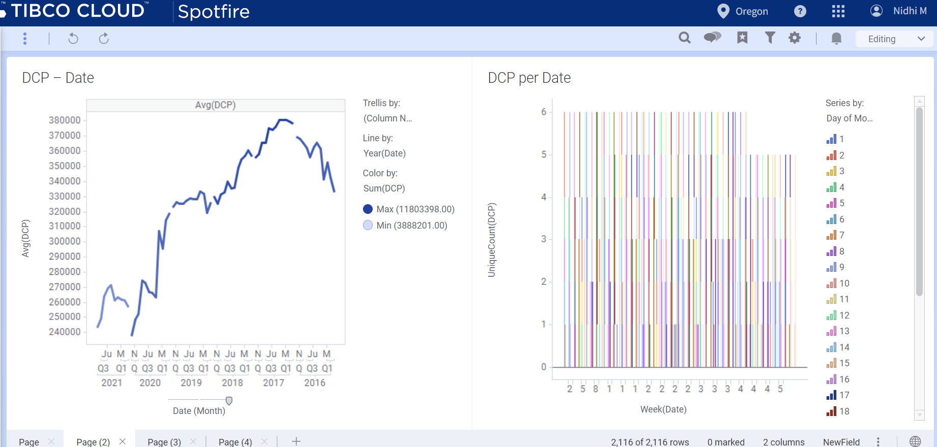

Slide 35
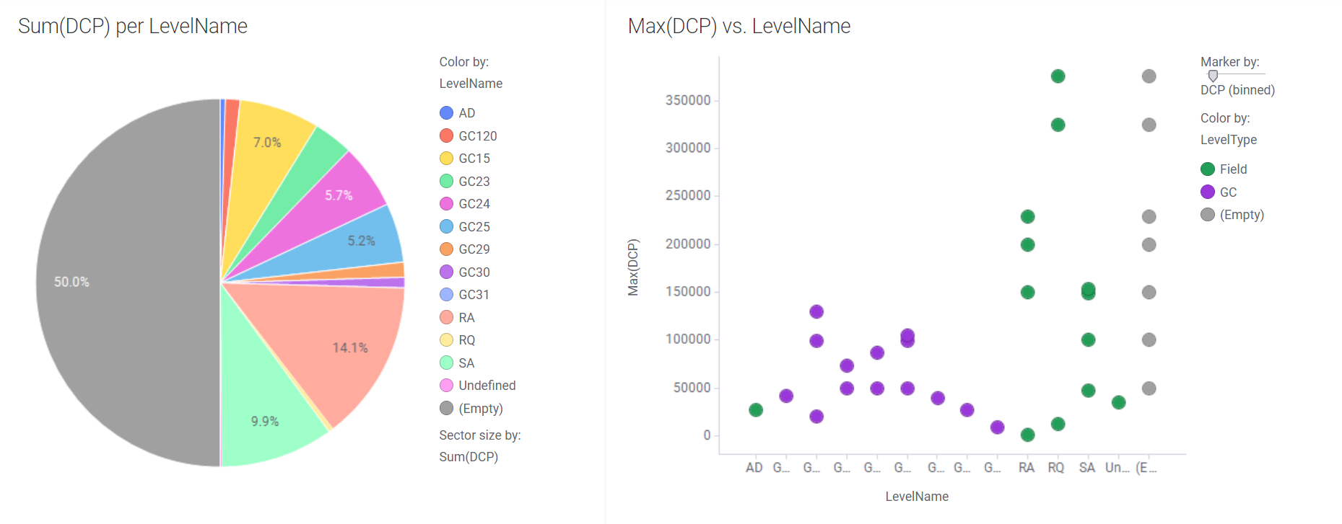

Slide 36
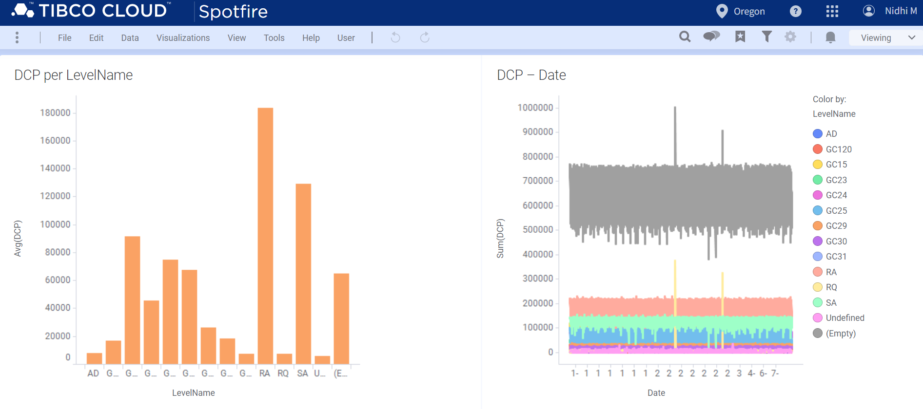

Slide 37
